Slide 1
Chapter 18

Slide 2
Objectives

Slide 3
Objectives (cont.)

Slide 4
Objectives (cont.)

Slide 5
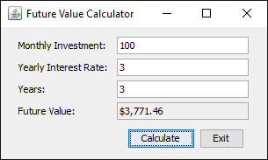
A Swing GUI that displays 10 controls

Slide 6
Common GUI libraries for Java

Slide 7
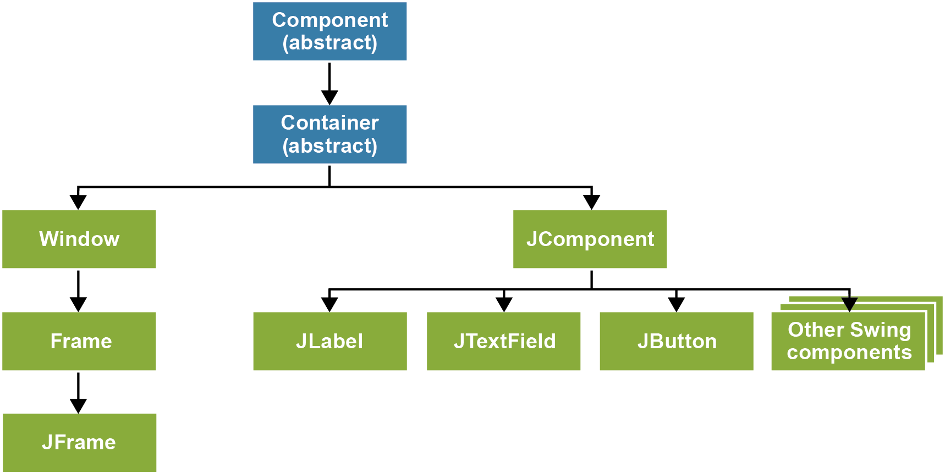
The Swing inheritance hierarchy

Slide 8
The package for most AWT classes

Slide 9
Common methods of the JFrame class

Slide 10
A class that creates and displays a frame

Slide 11
A class that creates and displays a frame (cont.)

Slide 12
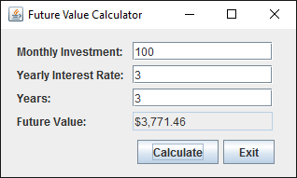
The Metal look and feel on Windows 10

Slide 13
Code that sets the look and feel the same as the current operating system

Slide 14

The Windows 10 look and feel

Slide 15
A method of the JFrame and JPanel classes

Slide 16
Code that adds a panel to a frame

Slide 17
The package that contains the events

Slide 18
How to add an action listener to a button

Slide 19
How to add an action listener to a button (cont.)

Slide 20
The JLabel class

Slide 21
How to create a JLabel and add it to a container

Slide 22
Code that adds four labels to a panel

Slide 23
The JTextField class

Slide 24
How to create a text box for approximately 20 characters

Slide 25
Code that adds two labels and two text fields

Slide 26
The package that contains the layout managers

Slide 27
A common constructor of the FlowLayout class

Slide 28
FlowLayout when all components fit on one line

Slide 29
A common method of the BorderLayout class

Slide 30
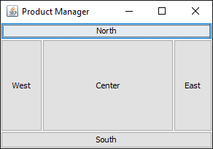
The resulting BorderLayout

Slide 31
GridBagConstraints fields for controlling layout

Slide 32
Code that uses a GridBagConstraints object to control layout

Slide 33
Code that uses a GridBagConstraints object to control layout (cont.)

Slide 34
GridBagConstraints fields for controlling padding

Slide 35
How to use insets to add padding

Slide 36
A common problem after horizontal resizing

Slide 37
Code that sets the preferred and maximum sizes

Slide 38
Three ways to fix this problem

Slide 39
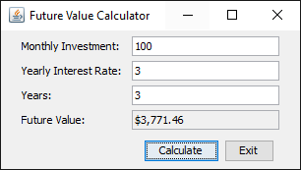
The Future Value Calculator form

Slide 40
The FutureValueFrame class

Slide 41
The FutureValueFrame class (cont.)

Slide 42
The FutureValueFrame class (cont.)

Slide 43
The FutureValueFrame class (cont.)

Slide 44
The FutureValueFrame class (cont.)

Slide 45
The FutureValueFrame class (cont.)

Slide 46
The FutureValueFrame class (cont.)

Slide 47
The showMessageDialog() method of the JOptionPane class

Slide 48
An error message in a JOptionPane dialog box

Slide 49
Code that checks if an entry has been made

Slide 50
Code that checks if an entry is a valid number

Slide 51
The code for the Validation class

Slide 52
The code for the Validation class (cont.)

Slide 53
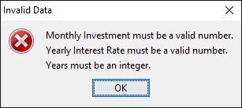
A validation dialog box with three error messages

Slide 54
Code that validates multiple entries

Slide 55
Code that validates multiple entries (cont.)

